Slide 1

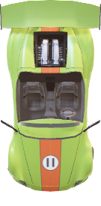
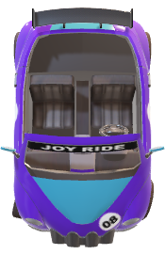
Smart and Effective Realtime Management of Street Parking
Under the guidance of :-
Mr. Ashish Golghate
[ASST PROFESSOR]

Slide 2





Overview
Introduction
Objectives
Methodology
Additional Features
Technologies Used
Outcomes
Research paper

Slide 3
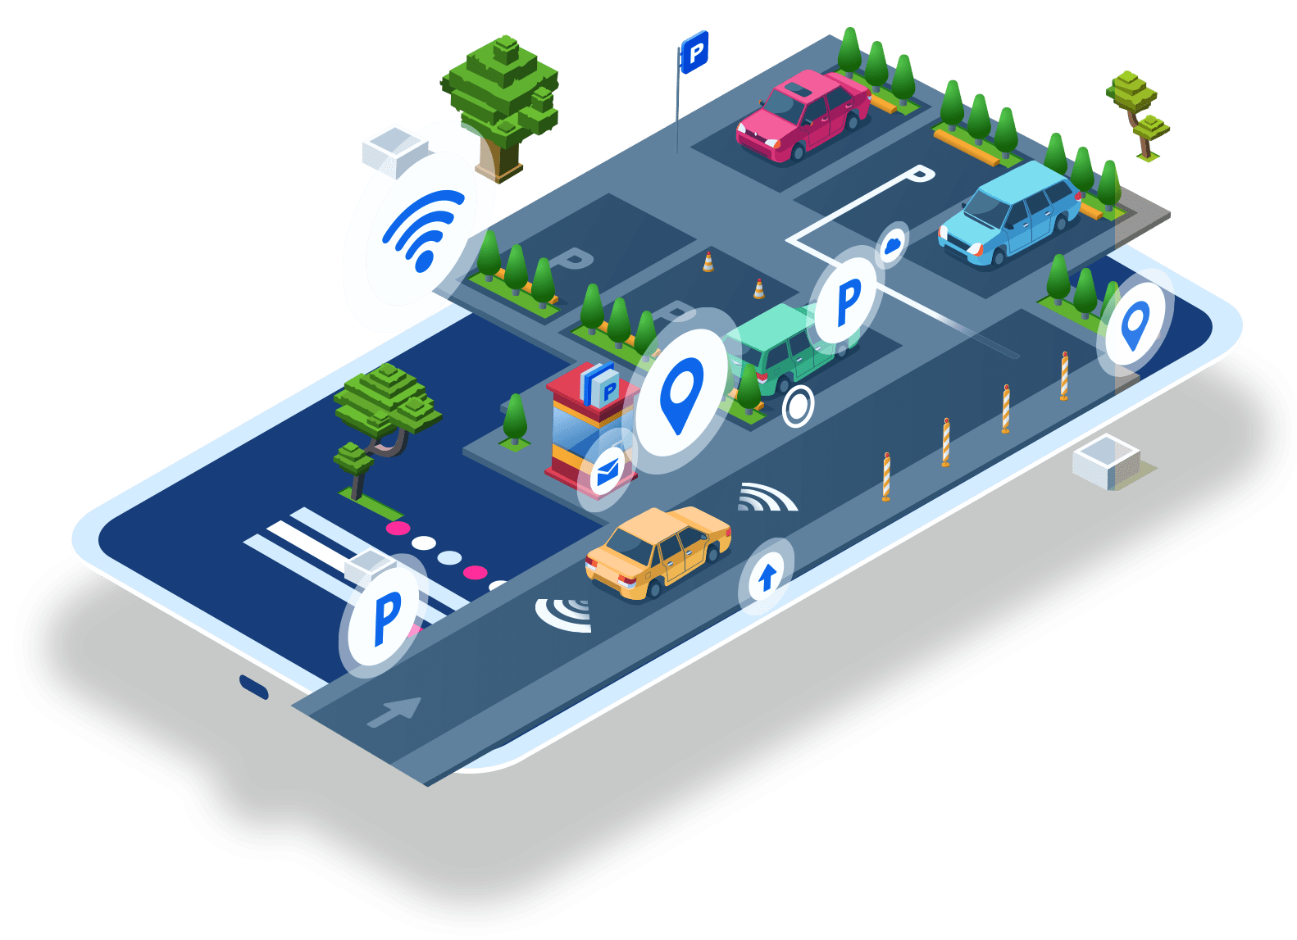
Introduction
In India, the surge in vehicles has outstripped available parking space, leading to traffic congestion and illegal parking. Smart parking solutions, powered by sensors and software, offer real-time data on parking availability. By optimizing prices and enabling reservations via mobile apps, we can save time, reduce environmental impact, and enhance revenue. These innovative tools address traffic and mobility challenges effectively.

Slide 4
Objectives:
Optimize Parking Utilization: Implement smart parking solutions to efficiently utilize existing parking spaces by providing real-time information on availability to drivers and city officials.
Reduce Traffic Congestion: By providing accurate information on available parking spaces, the project aims to reduce traffic congestion caused by vehicles circling around in search of parking.
Improve Environmental Quality: By reducing traffic congestion and emissions associated with vehicle idling, the project aims to contribute to improved air quality and reduced environmental degradation in urban areas.
Enhance Citizen Convenience: Develop a user-friendly mobile application that allows citizens to conveniently reserve parking spots and make payments based on dynamic pricing, reducing the time spent searching for parking.

Slide 5
Methodology
User will open the Web or mobile application to locate the parking facility.
With the help of camera and sensor we will check the availability of parking space.
If the parking space is available he will be directed toward the location.
Web / Mobile App
Data Collection & Analysis
Technology implementation (sensor-based technology )
Return to user
Parking space is checked
real time monitoring

Slide 6
ADDITIONAL FEATURES :
1. Augmented Reality-Enhanced Real- Time Parking Space Tracking System
For interactivity and 3-D navigation for Reality-Enhanced Real-Time Parking Space Tracking System
2. AQI Tracker for Pollution Control
Our application also tracks AQI of particular parking locations. If the AQI exceeds the limit, a notification will be sent to MDDA of that area.
3. Computer Vision and Sensor based Proctoring
Revolutionize parking enforcement with our Computer Vision system. It autonomously detects and imposes fines on vehicles parked illegally, ensuring stricter compliance with parking regulations.
4. Reduced bouncing rate Optimizing Traffic Congestion
Charging users based on their actual parking duration while strictly enforcing penalties for overtime parking, reducing congestion and improving compliance

Slide 7

Technologies Used
• Flutter Android and Ios
• Next.js/React.js, MongoDB, Node.js/Express.js
• Arduino Uno - Hardware
• Cyber Security - Payment
Authentication & Encryption
• AI/ML and Deep Learning / Computer Vision
• Spark AR AR based parking navigation

Slide 8
Outcome
Parking related Created issues will be solved.
Customer satisfaction.
Environmental Related issues will be solved like air purification and and reduced environmental degradation in urban areas.
It will Promote Sustainable Revenue Generation for city administration.
By using this project it will help Foster Innovation and Technological Adoption such as sensor-based parking systems and mobile applications

Slide 9
Research Paper
"Smart Parking Solutions for Urban Mobility Management" by X. Liu et al. (2019)
"Dynamic Pricing Strategies for Parking Management" by Y. Zhang et al. (2020)
"Integration of Sensor-Based Parking Systems with Smart Cities" by A. Rahman et al. (2018)
"Mobile Application Development for Urban Parking Solutions" by K. Gupta et al. (2021)
"Challenges and Opportunities in Implementing Smart Parking Systems in Developing Countries" by R. Sharma et al. (2017)

Slide 10
Thank you

